Slide 1

Principal Component Analysis
Presented By:
Sumukha Sharma T.C.
Aaryan Agarwal
Prajwal Kaushal

Slide 2
Index
Introduction Dimensionality
Introduction PCA
About the data
Task 1
Task 2
Task 3
Task 4
Task 5
Conclusion

Slide 3
Curse OF Dimensionality
As we add more dimensions to the dataset, the space it occupies increases exponentially which leads to sparse data
Problems with curse of dimensionality are Data Sparsity, Increased Computation, Overfitting, etc.

Slide 4
CURSE OF DIMENSIONALITY ConTi...
Feature Selection
Information Gain
Correlation Coefficient
Dimensionality Reduction
Principal Component Analysis
Linear Discriminant Analysis

Slide 5

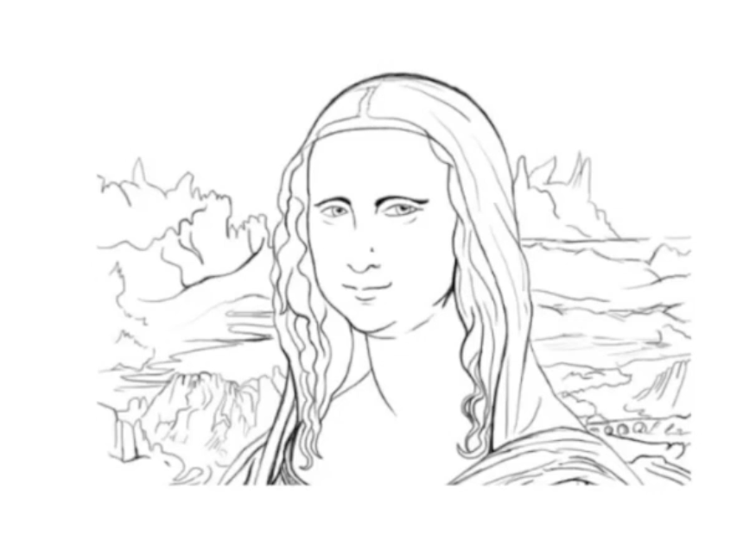
Dimensionality REDUCTION
Dimensionality reduction is the process of reducing the number of features in a dataset while retaining as much information as possible
Reduces the complexity of the model and improves its generalization performance

Slide 6

Principal COMPONENT ANALYSIS
Principal Component Analysis (PCA) is a statistical procedure that reduces the dimensionality of large data sets. It's a popular technique for analyzing data that contains a high number of dimensions.

Slide 7
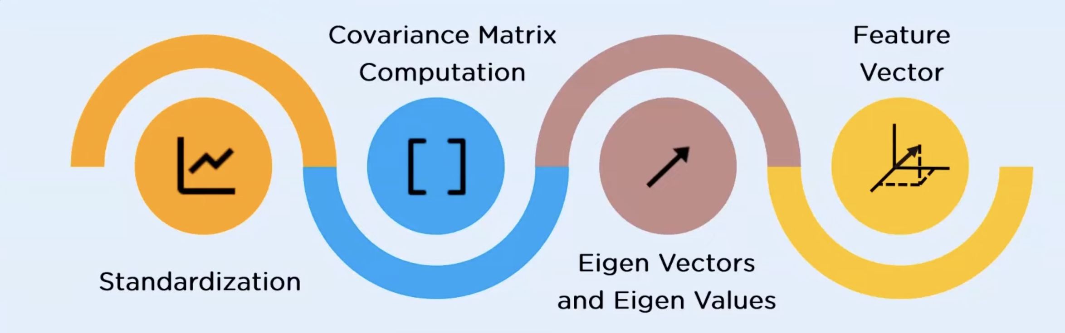
Working of PCA

Slide 8
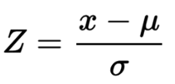
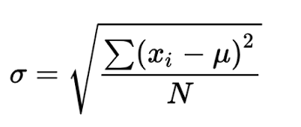
STANDARDIZATION
The main aim of this step is to standardize the range of attributes such that each of the feature lie in the similar boundary

Slide 9
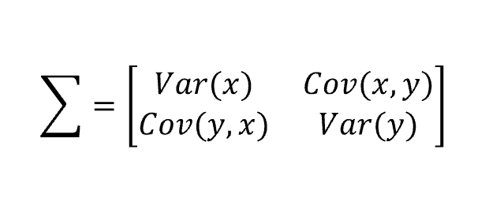
Covariance MATRIX
Covariance matrix is use to express the correlation between any two or more attributes in a multidimensional dataset

Slide 10
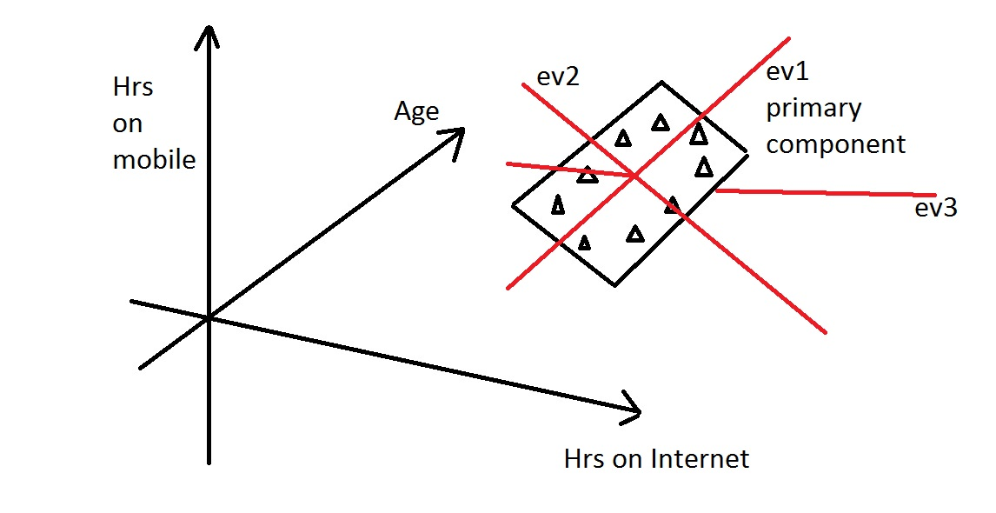
Eigen VALUES AND EIGEN VECTORS
Eigen values and Eigen Vectors are the mathematical values obtained from the covariance table

Slide 11
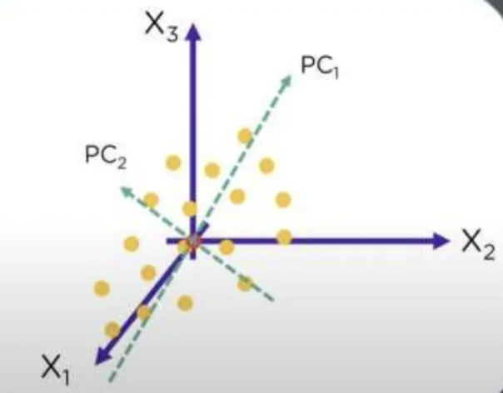
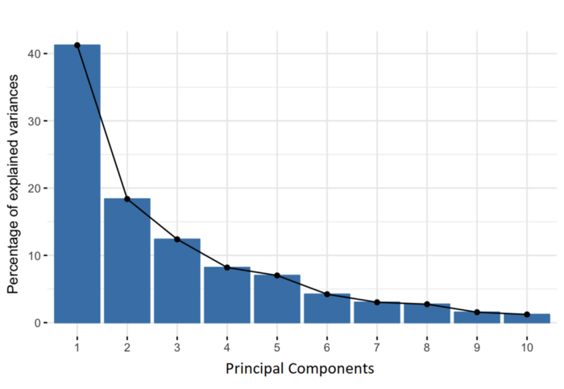
Selection of the PRINCIPAL COMPONENT
The first principal component represents the maximum variance direction in the data
Second is the next direction of greatest variability

Slide 12
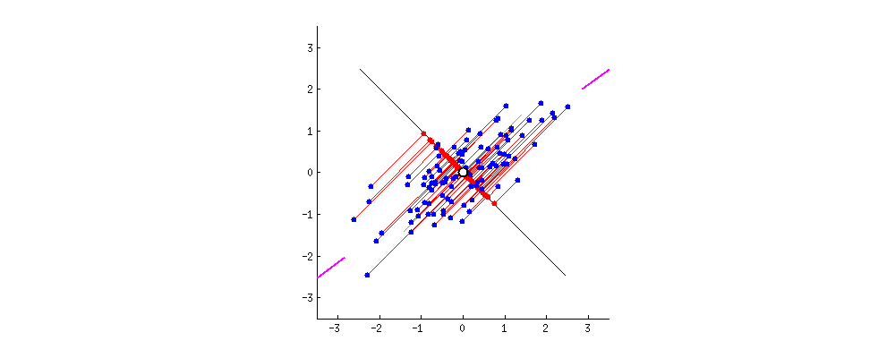
Projection MaTRIX
Form a Projection Matrix using selected principal components.
Multiply the standardized data by the projection matrix
Analyze the results in the lower dimension space
After projecting the original data onto the principal components , each observation is represented by PC score.

Slide 13


Problem STATEMENT
Applying PCA to unravel the complexities in US Congressional voters and understanding deeper patterns and trends that govern the voting behaviors in US Congress.

Slide 14
About the Data
The data consists of 445 entries which are the names of the congressmen in the congress.
Each congressmen has 1647 number of votes.
Each columns consists of 3 types of votes:
0 for abstention, 1 for ‘yea’ and -1 for ‘nea’.
The dataset has no NAN values and doesn’t require much preprocessing.

Slide 15

Task 1
Running PCA on the voting data.
Visualize the PCA results.
Visualize the importance of each principal component and decide on the number of PCs to use

Slide 16
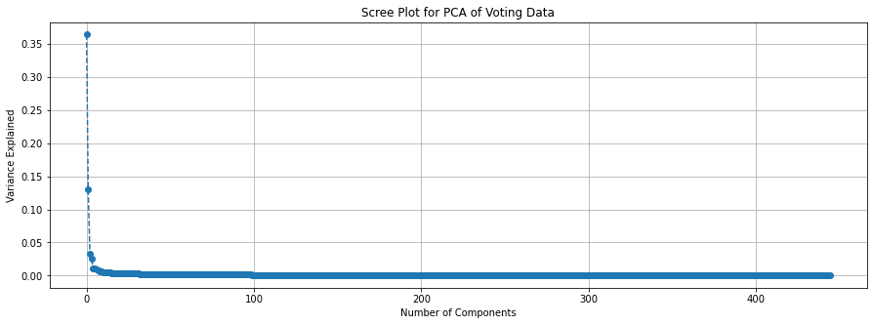
Running PCA
We ran PCA on the voting data and got the following scree plot.
Looking at the graph we can see a significant drop in the variance when we move to higher components.
This plot helps identify where the 'elbow' is, which is the point after which additional components contribute less to the explanation of variance.
The 'elbow' method is a heuristic used in determining the number of components to keep.

Slide 17
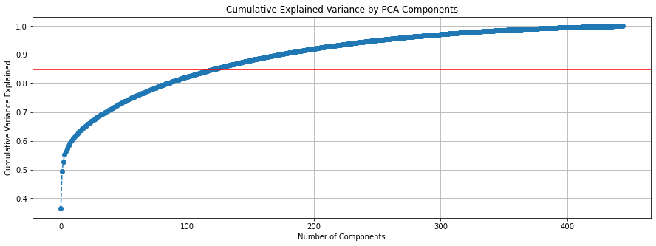
Choosing PCs
The cumulative variance plot is a visualization of the cumulative sum of explained variances by the components.
The horizontal red line marks the 85% threshold, which is a common cut-off for sufficient variance explanation in many applications.
The plot indicates that 122 components are needed to explain approximately 85% of the variance in the data.

Slide 18
Interpretation of the graphs
With 122 components explaining 85% of the variance, it suggests that the voting patterns are multifaceted.
While the first few components capture the most significant patterns of variance, additional components are needed to capture the subtler, yet substantial, aspects of the data.
The analysis shows that while it's possible to reduce the dimensionality of the data significantly, a relatively large number of dimensions are still required to capture most of the information in the original data.
This highlights the complexity of the voting behavior in the dataset and suggests that many nuances would be lost if the dimensionality were reduced too drastically.

Slide 19
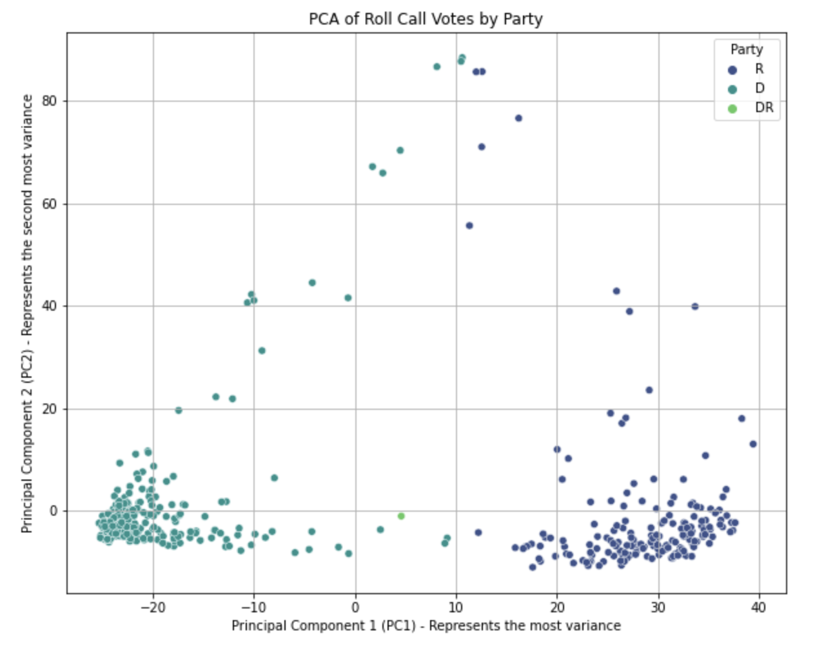
PC1 vs pc2

Slide 20
PC1 vs pc2 ConTI
The 'R' (presumably Republican) party members tend to have positive scores on PC1.
The 'D' (presumably Democrat) party members tend to have negative scores on PC1.
Members labeled as 'DR' are situated in the middle to the right side of the plot, which could represent independent members or those with mixed party affiliations.
Polarization: The clear separation along PC1 may suggest a strong polarization in voting behavior between the two major parties, with each party clustering on opposite sides of the plot. This is consistent with the expected political divisions in a two-party system.
Outliers: There are a few data points with extreme values on PC2, both positive and negative. These could be legislators who have voting records that are highly atypical compared to their colleagues, perhaps voting frequently against party lines or on specific issues that are not as strongly correlated with the main axis of party division.
Potential Subgroup Identification: If we look at the distribution of 'DR' points, they do not form a separate cluster but rather are placed within the spread of the other parties, suggesting that these members' voting behavior is somewhat aligned with the major parties but with some variance.
Dimensionality of Voting Behavior: While PC1 seems to capture a significant variance along party lines, PC2 might be capturing a more issue-specific aspect of voting that doesn't separate along the same axis as party affiliation

Slide 21
Task 2
How do you interpret the factor / principal component scores for each legislator? Specially the ones associated with the first principal component.
What do the legislators’ voting behavior from this analysis suggest?
Which legislators have the most extreme principal component scores?

Slide 22
Top legislator by pc1 score
The legislators with the highest PC1 scores are predominantly from the Republican party (R), as indicated by the data.
This suggests that the first principal component may be capturing a dimension of variance that aligns with a particular aspect of conservative voting behavior or perhaps specific issues that these legislators tend to vote similarly on.
The fact that these legislators stand out on PC1 could mean they are more consistent or extreme in this behavior compared to their peers.

Slide 23
Bottom legislators by pc1 score
Conversely, the legislators with the lowest PC1 scores are from the Democratic party (D), indicating that PC1 also captures variance in voting behavior that aligns with liberal voting patterns.
Legislators with the most negative scores on PC1 may represent a liberal equivalent to the conservative pattern captured by the positive end of PC1.

Slide 24
Interpretation of pc1
The first principal component appears to be a strong indicator of partisan voting behavior, distinguishing between Republican and Democratic patterns.
This is not entirely surprising given the polarized nature of US politics

Slide 25

Surprises and learning points
The result of this analysis may shock some people, especially regarding the magnitude of scores and distinctiveness between the two parties.
This means that one single principal component can account for a good proportion of partisan differences in electoral behavior.
The legislators with the largest and smallest PC1 scores could be of particular interest for a more detailed analysis.
Their voting records could be examined to understand which specific issues they are more likely to vote for or against, and whether their scores are a result of a few key votes or a general trend across many votes.

Slide 26
Task 3
Visualize the vote-loadings for the first principal component.
How do you interpret a negative/positive value here?

Slide 27
Understanding the task
What is a Loading in PCA?
Definition: "In PCA, a 'loading' is a coefficient that measures how much each original variable contributes to a principal component."
Function: "Loadings are used to transform data from its original variables into new principal components, which are linear combinations of these original variables."
Interpretation: "The magnitude and direction (positive or negative) of a loading indicate the influence of an original variable on the principal component."

Slide 28
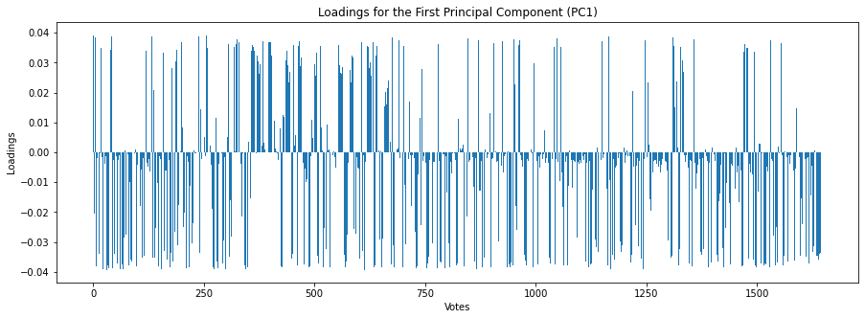
Observations from the plot
Variation in Loadings: There is considerable variation in the loadings, with both positive and negative values, suggesting that PC1 captures a complex pattern of voting behavior that includes both 'yea' and 'nay' votes.
Significant Votes: Votes that have higher positive or negative loadings are the ones that contribute most to PC1.
These votes could be considered significant in differentiating between the voting behaviors of legislators and could be further analyzed to understand the specific issues that are driving the pattern of variance captured by PC1.

Slide 29
How to interpret the loadings
Positive Loadings: Votes with positive loadings on PC1 suggest that legislators with a high score on this component tend to vote 'yea' on these issues.
The higher the loading, the more strongly a 'yea' vote on that issue is associated with the pattern captured by PC1.
Negative Loadings: Votes with negative loadings suggest that legislators with a high score on PC1 tend to vote 'nay' on these issues.
A lower (more negative) loading implies a stronger association with a 'nay' vote in the pattern captured by PC1.
Magnitude of Loadings: The magnitude (absolute value) of the loading indicates the strength of the association between the vote and PC1.
Larger magnitudes (both positive and negative) mean that the vote has a stronger relationship with the variance captured by PC1.

Slide 30
Task 4
Analyze the vote-loadings for the second principal component.
How would you characterize votes with large loadings?

Slide 31
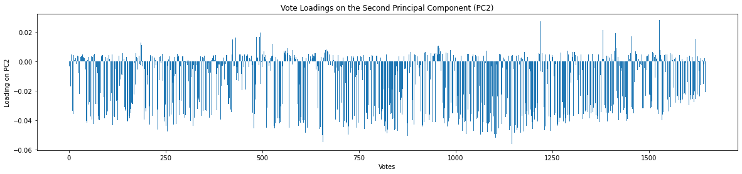
Plotting the PC2 Graph
The graph shows the plot for the second principal component that we obtained during PCA.
Comparing the PC1 and PC2 we can observe a lot of differences.

Slide 32
Characterization of votes. With large loadings on pc2
Votes with Large Positive Loadings: These votes are associated with a specific pattern that is different from the one captured by PC1.
This pattern could be related to issues that differentiate legislators in a way that is not strictly partisan but could be related to other factors such as ideology, geography, or specific interests
Votes with Large Negative Loadings: These votes represent another pattern that is also distinct from PC1.
Legislators who score low on PC2 might consistently vote against these issues, indicating a separate dimension of disagreement or agreement that is independent of the primary partisan divide.

Slide 33
insights
Votes with large loadings on PC2 can be characterized as those that capture variance in voting behavior not explained by PC1.
While PC1 might primarily capture the partisan divide, PC2 could be revealing other underlying factors influencing voting behavior.
This component might represent factors such as regional issues, the interests of specific constituencies, or coalitions on certain legislation.

Slide 34
Task 5
Analyze the scores associated with the second principal component for each legislator.
How would you characterize the legislators with large absolute values?
Are you surprised by your findings?

Slide 35
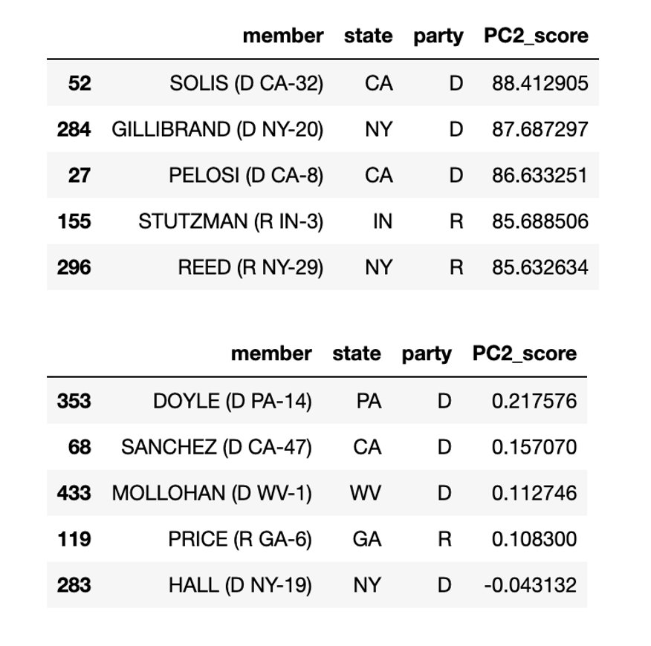
Legislators with largest absolute pc 2 scores
The legislators with the largest absolute values on PC2 are likely to exhibit voting behaviors that are distinct from the pattern captured by PC1.
These individuals could represent unique voting blocs or have voting patterns influenced by factors such as specific regional issues, individual ideologies, or a focus on a particular set of policies that differ from the broader party lines.¶
Interestingly, we see a mix of both Democrats (D) and Republicans (R) among the top scores on PC2, which suggests that PC2 captures a dimension of variance in voting behavior that transcends party affiliation.

Slide 36
Are the findings surprising?
It might be surprising to see such large scores on PC2, indicating that some legislators have voting patterns significantly different from the average.
It is also interesting to note that some high-profile names, like Nancy Pelosi, appear among the top scorers on PC2, which could indicate leadership roles, influence on legislation, or particular policy focuses that set them apart.

Slide 37

Characterization of legislators based on pc 2 scores
Legislators with large positive or negative PC2 scores could be seen as outliers or influencers within their respective groups.
Their voting records could be characterized by strong stances on certain issues or by a tendency to vote in opposition to their party's mainstream on specific key votes.
On the other hand, legislators with small absolute PC2 scores may have voting patterns that are more in
line with the average legislator's behavior and do not stand out on the dimension captured by PC2.

Slide 38

CONCLUSION: Insights FROM PCA ANALYSIS
Complex Nature of voting behavior
Revealed multifaceted patterns beyond party lines.
Insights from principal components
PC1: Clear partisan divide (Republican vs Democrat).
PC2: Additional influences (regional, ideological, policy-specific).
Roles and behaviors of legislators
Identified key influencers and outliers.
Highlighted unique voting patterns of high profile legislators.
Deeper Legislative Dynamics
PCA as a tool in understanding intricate political behaviors.
Insightful for discussing political strategies and strategies.

Slide 39

Thank you

